Slide 1
Data Career
How can you stand out and how much should you ask for?
An analysis on Salary and Skills related to a Data Career.
By Farid Mokhtar, Dec 2023

Slide 2

Background
Demand for data-related talent has risen in Singapore and around the world in recent years.
According to U.S. Bureau of Labor Statistics, the demand for data science talents increase by 35% annually.
Here in Singapore, according to a study done by Trust Recruit, there are a total of 4,000 Data Scientists and 5,200 Data Analyst roles made available in the year 2023.
Data Scientists are now one of the top five in-demand hiring roles in Singapore as of Sept 2023.

Slide 3
Common problem
According to CareerBuilder, 73% of employers in the US expect a salary negotiation on an initial job offer, while 55% of candidates do not try to negotiate for a pay rise due to feeling uncomfortable or fear of not being liked by the employer.
A well-known 2010 study by Princeton researchers Daniel Kahneman and Angus Deaton found that people tend to feel happier the more money they make, up until a point, which Kahneman and Deaton estimated to be about $75,000 a year per person.

Slide 4
Problem Statement
As we go through the job search process, how much salary are we expected to negotiate for in today’s market for a data-related career?
On top of that what other skills are we expected to have to fulfill the requirements of a data-related role?

Slide 5
Problem Statement 1
Objective of this project: To create a model that helps us predict the mean salary based on several features related to the job role.
Why it is important: To enable job seekers looking for a data role a starting point during salary negotiation based on current market trend. This ensures they are not priced out and be able to command a rate based on market trends and the requirements of the role.

Slide 6
Problem Statement 2
Objective of this project: To create a word cloud of the most common associated words/skills in the job description to pick out areas for learning to be able to meet the requirements of the data-related job desired.
Why is it important: Having strong knowledge on python language and model programming is not enough to secure a role. There are other aspects of the roles and the skills related to it that companies are looking for that will make the candidate stand out.

Slide 7
Process
Problem Statement
Data Extraction / Collection
Data Transformation
Initial Data visualisation
Choose & Build Model
Model Evaluation
Model Deployment
Model GOvernance

Slide 8
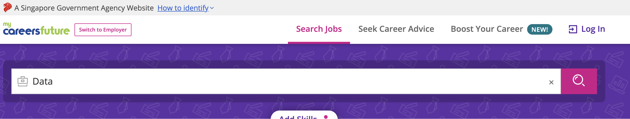
Data Extraction / Collection
Dataset: Data-related job postings that was scraped from MyCareersfuture*
This dataset contains 1900 job postings based on search results using the term ‘Data’.
*Scraping exercise done by Darren Chia: https://github.com/sgdarrenchia/project4_job_postings/blob/master/Project_4_Selenium_Web_Scraping%20.ipynb

Slide 9
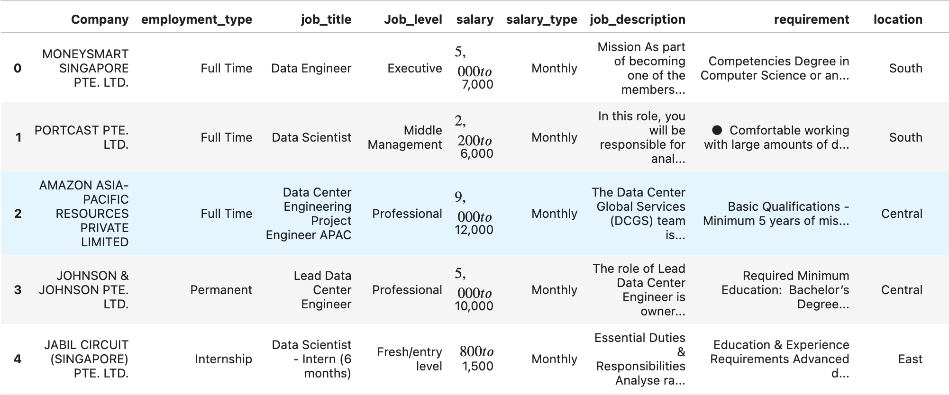
Data Cleaning
Features such as years of experience and education contained in the requirement column.
Categorical features engineering
Difference in salary_type
Outliers
Missing data

Slide 10

Initial Data Visualization
There are a lot of features contained in the dataset:
Location – Office from which the job will be based in (eg. North, South, East, West)
Job Level – The formal job level associated with the role (Eg. Fresh Grad, Executive)
Nature of scope – The data-related role’s scope (Eg. Analyst, Scientist, Engineer, Cloud)
Years of experience – Continuous variable from 0 to 20 years.
Education – Certifications and education requirements (Eg. Degree, Diploma, NITEC)
Mean salary – Average of the maximum and minimum salary provided in the range.

Slide 11
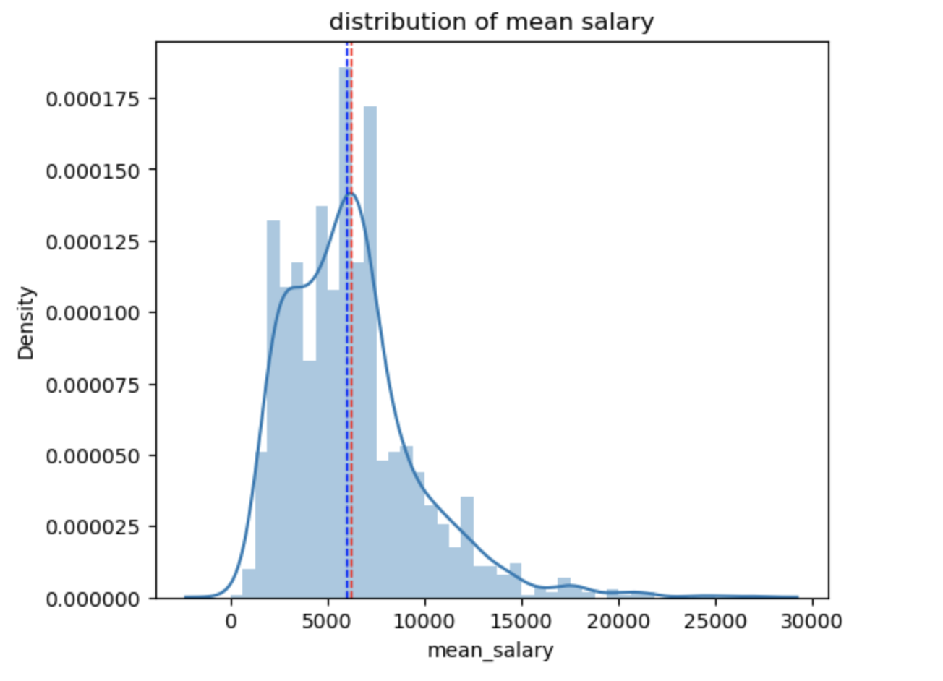
Initial Data Visualization
Target: Mean salary
Including all the data-related roles into the distribution, we can see that the mean salary falls between the range of $6,000 to $6,500.
As of Jan 2023, the average monthly salary in Singapore is $5,783*
Notes:
According to : https://www.resumewriter.sg/blog/salary-guide-singapore/#:~:text=com%20%7C%20Statistics%20Singapore-,What's%20the%20average%20salary%20in%20Singapore%3F,CPF%20contributions%2C%20is%20S%244%2C563.

Slide 12
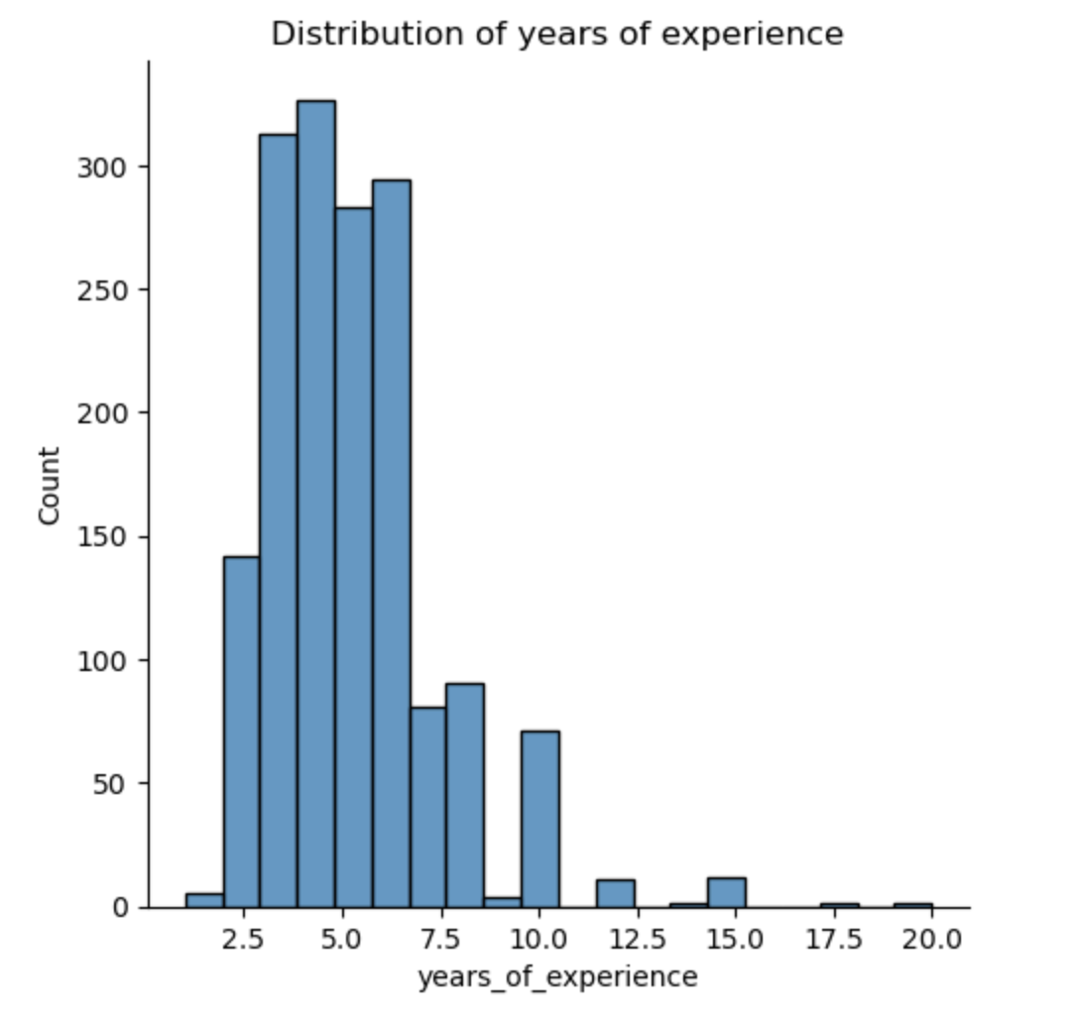
Initial Data Visualization
Years of experience
Majority of the job listings (interquartile range) require between 3 to 7 years of experience.

Slide 13
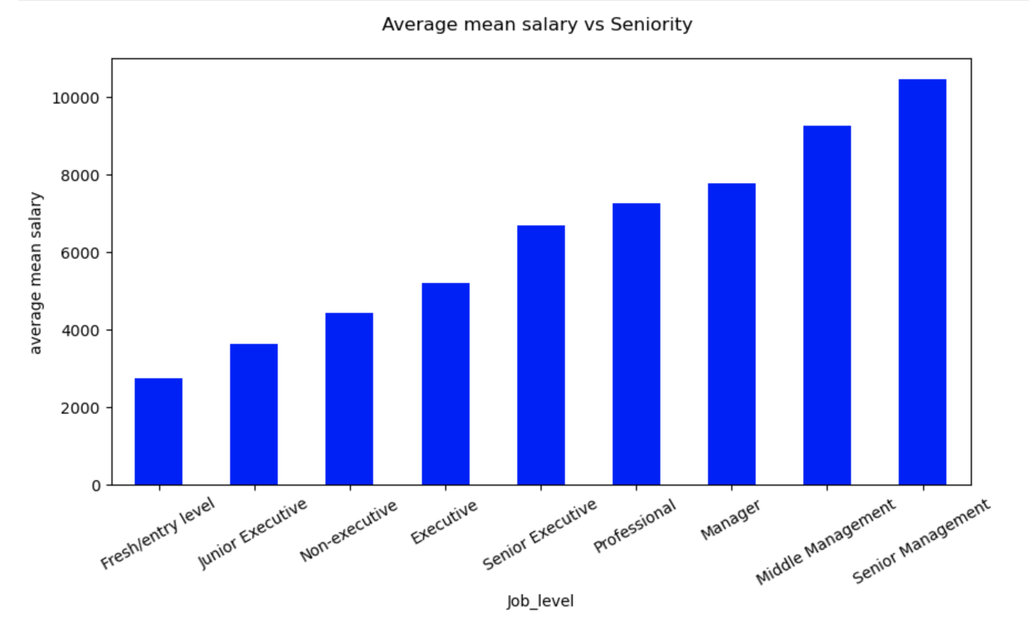
Initial Data Visualisation
The average mean salary corresponding to seniority of the role.
A fresh/entry level data-related role commands a salary of $3000 on average but of course this doesn’t count other factors/features.

Slide 14
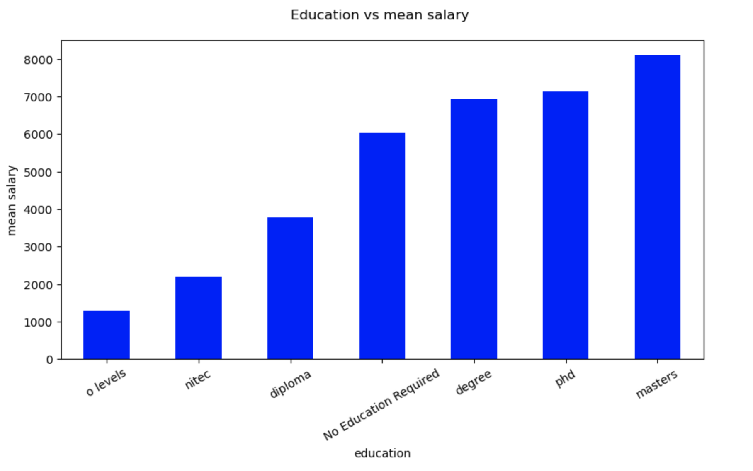
Initial Data Visualisation
For a data-related role, education is a very distinctive feature on how much salary can you command or negotiate for.
Masters > PHD due to the nature of the scope relating to the roles. (PHD more academic scope vs Masters in an operational scope)
No education required – Refers to certification or jobs that values experience more than education.

Slide 15
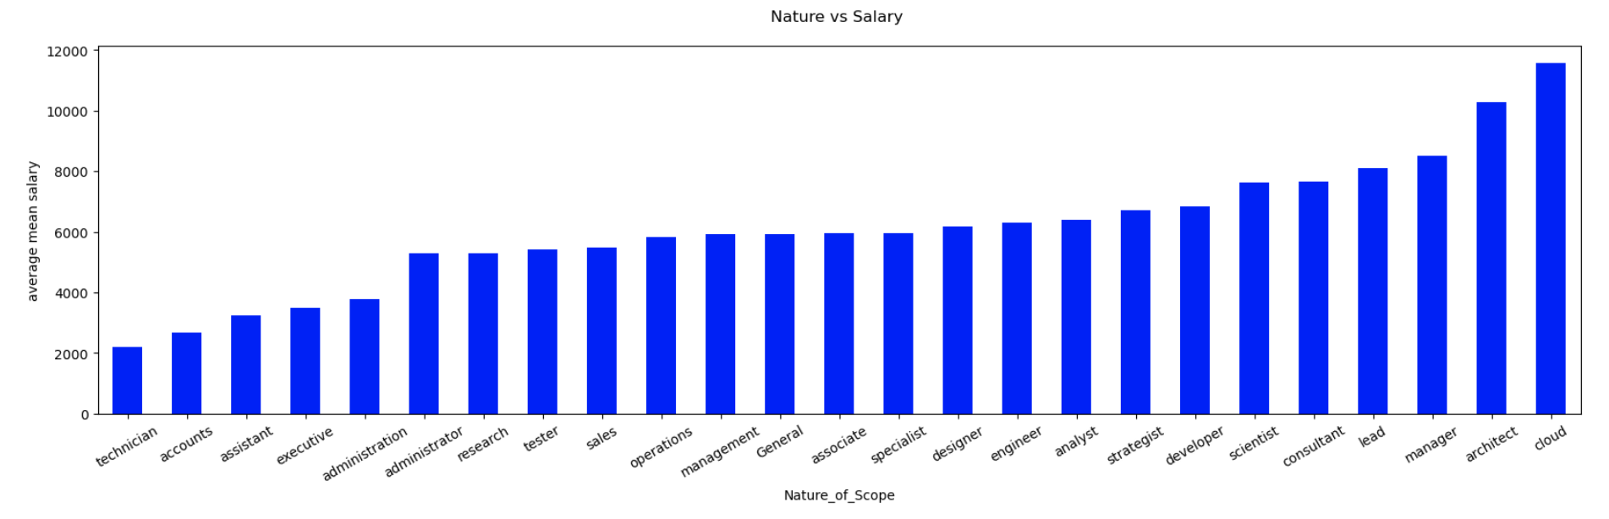
Initial Data Visualisation
Data-related roles in the area of cloud commands the highest mean salary based on the dataset.
Analyst and scientist with different scopes get to command different salaries due to major difference in scopes.

Slide 16
Model
Features (X): Job level, Nature of scope, Years of experience, Education
Output(y): Mean salary (+- $1K)

Slide 17
Evaluation of models
Multi-linear regression
Score: 0.41
SVR(Support Vector Regression) model
Score: 0.39
Random forest
Score: 0.5

Slide 18
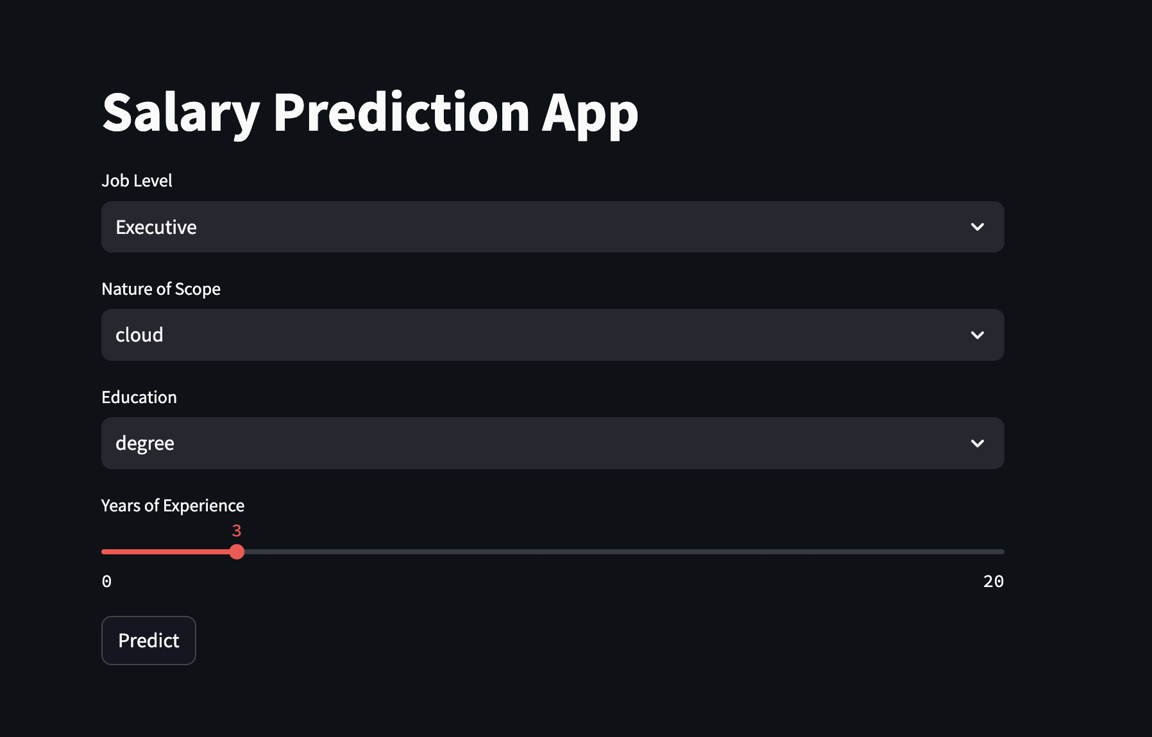
Deployment of model
Random forest
Score: 0.5
Demo for deployment to predict salary using the streamlit app.

Slide 19
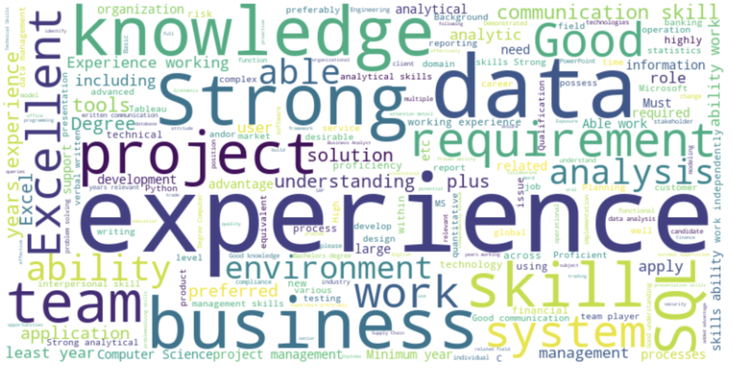
Wordcloud
For Data Analyst roles, here are some important keywords / skills to stand out from the crowd:
SQL skills
Project management
Degree
Analytical Skills
Communication Skills

Slide 20
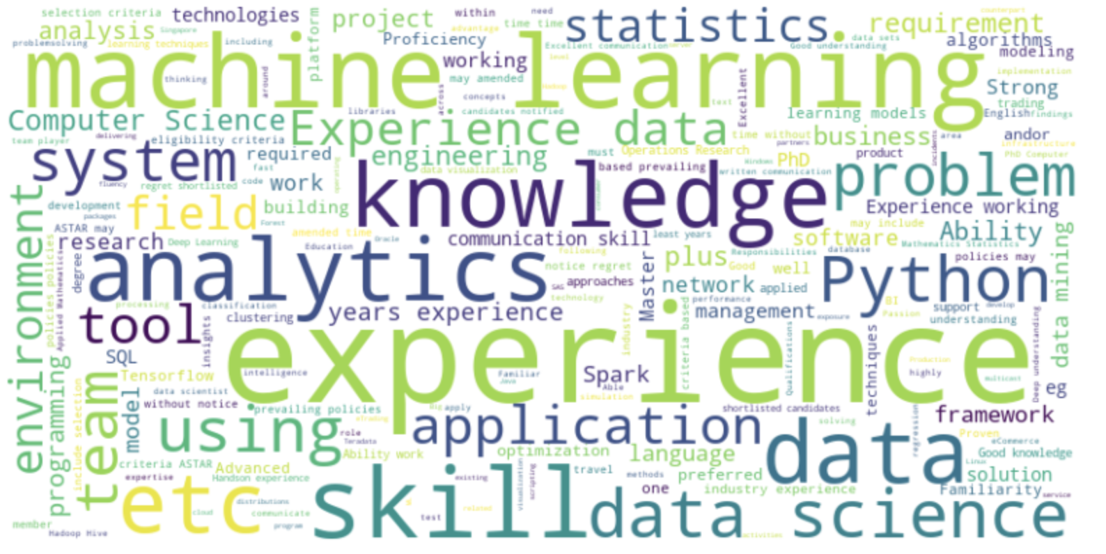
Wordcloud
For Data Scientist roles, here are some important keywords/skills that enable you to stand out:
Machine Learning
Statistics
Python
Analytical skills
Data Mining
Learning Models
Communication skills

Slide 21
Summary
This model is just a guidance. It is meant to serve as a data-backed starting point in salary negotiations.
By analyzing the list of other common skills required in job postings, we get to work on complementing skills that will make you stand out from the crowd.

Slide 22
Learnings / Next steps
Model can be improved - The model score suggests that the changes in mean salary can be predicted 50% of the time by the features we have. More data or features are required to improve on the data score.
Other skills required – To be able to excel and fulfill the requirements of companies looking for data talents, we need to be able to have the flexibility in excelling in non-data aspects such as communication skills.

Slide 23
Questions?

